Slide 1
Containerised Microservices on AWS
Implementation, Benefits, Challenges & Next Steps
Assessment Presentation
Tech Stack: Docker • CloudFormation • ECR • ECS Fargate • ALB • CodePipeline/CodeBuild • CloudWatch/SNS
Format
Designed for ~10 minutes. 1 slide ≈ 45–60 sec.
Cloud-Native DevOps & Platform Engineering | Assessment

Slide 2
Agenda
What we’ll cover
Project overview & objectives
Architecture design (microservices + AWS)
Implementation process (IaC + container build + deploy)
CI/CD pipeline automation
Monitoring, alerting & validation
Benefits realised
Challenges faced & resolutions
Strategic next steps
Outcome
A repeatable, secure, and observable deployment using AWS-native services.
Deliverables
• Dockerised frontend & backend • Single CloudFormation stack • Automated CI pipeline • CloudWatch dashboard + alarms • SNS email notifications
Cloud-Native DevOps & Platform Engineering | Assessment

Slide 3
Overview
Project overview & objectives
Deploy a two-service microservices application (Frontend + Backend).
Use containerisation for portability and consistent runtime.
Provision AWS infrastructure fully via Infrastructure as Code (CloudFormation).
Enable automated build and publish via CI pipeline.
Implement observability: dashboards, alarms, and email notifications.
Validate end-to-end traffic flow via Application Load Balancer.
Key AWS services
ECR, ECS (Fargate), ALB, VPC/Subnets/SGs, IAM, CodePipeline/CodeBuild, CloudWatch, SNS
Success criteria
Accessible frontend via ALB DNS, both tasks running, automated build to ECR, alarm triggers + email received.
Cloud-Native DevOps & Platform Engineering | Assessment

Slide 4
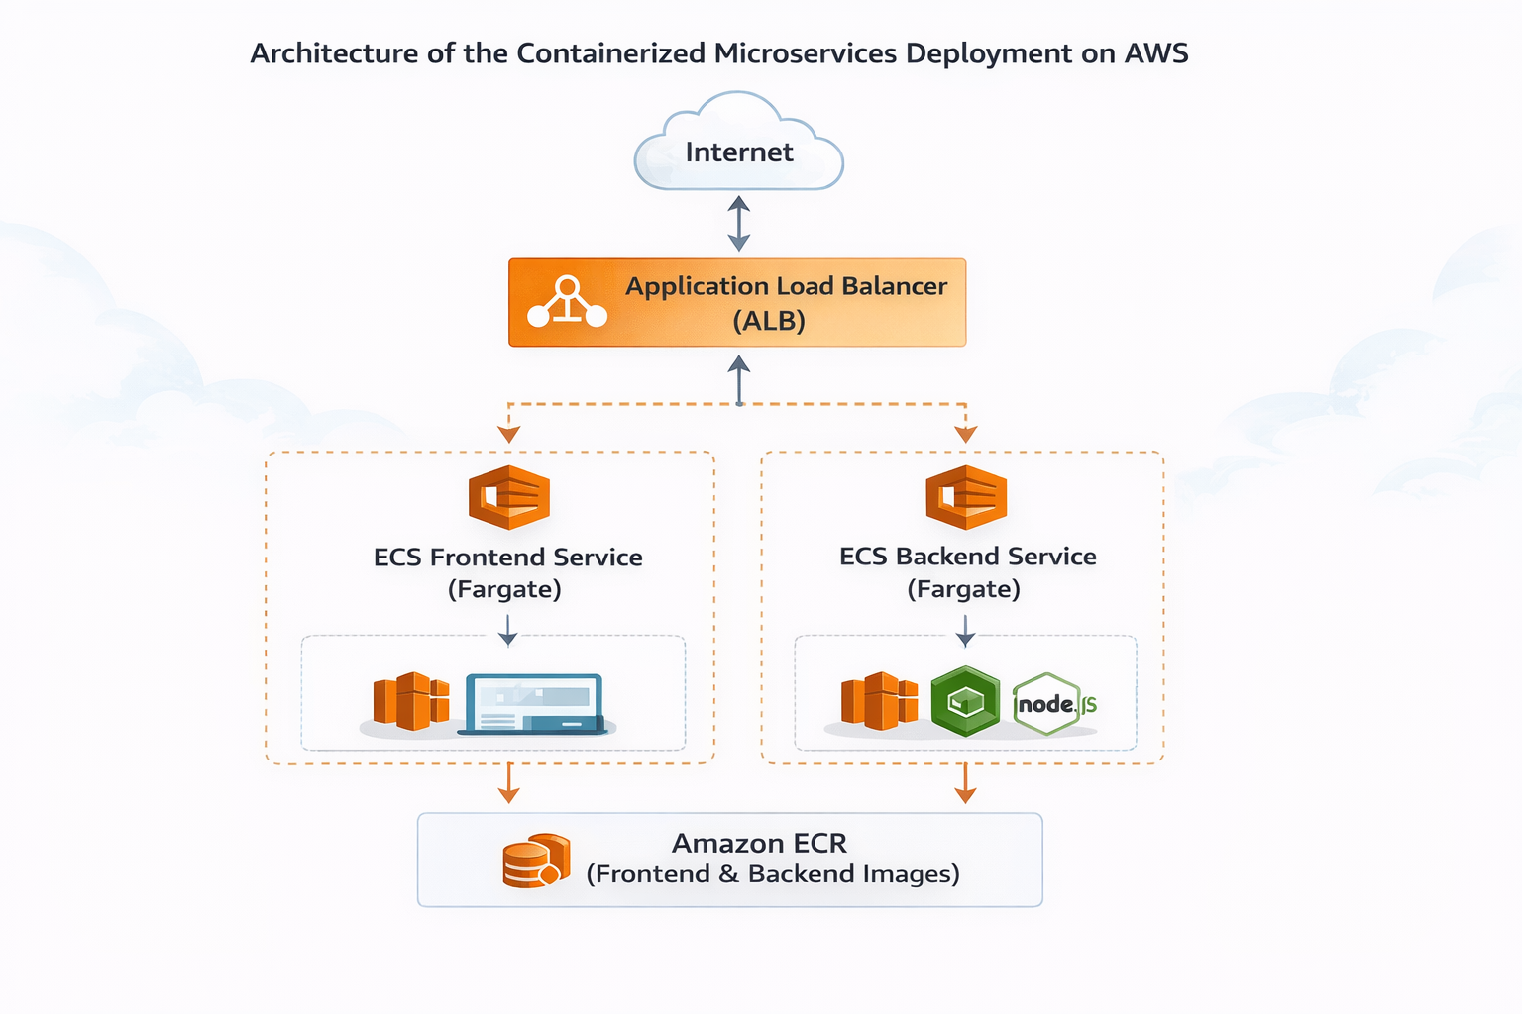
Architecture
Microservices deployment architecture (AWS)
Cloud-Native DevOps & Platform Engineering | Assessment

Slide 5
Implementation
Implementation process (end-to-end)
1) Containerise services using Docker (frontend + backend).
2) Build & test locally to validate ports and endpoints.
3) Provision infrastructure using a single CloudFormation template.
4) Create ECR repositories and push versioned images.
5) Deploy ECS services (Fargate) and attach to ALB target groups.
6) Validate via AWS CLI + browser (ALB DNS).
7) Configure CI pipeline to build and push images automatically.
8) Configure CloudWatch dashboard, alarms, and SNS notifications.
IaC highlights
• VPC + public/private subnets • Route tables + IGW • Security groups (least privilege) • ECS cluster + task defs + services • ALB listener + target groups • IAM execution role + logs
Validation
• CloudFormation: CREATE_COMPLETE • ECS tasks: 1/1 running • ALB reachable • Logs in CloudWatch • Alarm test via load generation
Cloud-Native DevOps & Platform Engineering | Assessment

Slide 6
Infrastructure as Code
CloudFormation: repeatable infrastructure deployment
Single declarative CloudFormation template defines networking, compute, IAM, and load balancing.
Template validation performed using AWS CLI (validate-template).
Parameters used for reusable deployments (AppName, CIDRs, container ports, image URIs).
CLI verification used to confirm stack resources and status.
Results: infrastructure deployed consistently without manual console configuration.
Why IaC?
Repeatability • Consistency • Auditability • Faster recovery • No configuration drift
Core resources
VPC, subnets, route tables, IGW, SGs, ECR repos, ECS cluster/services, task definitions, ALB, target groups, IAM role, CloudWatch logs
Cloud-Native DevOps & Platform Engineering | Assessment

Slide 7
CI/CD
Continuous Integration pipeline (GitHub → AWS)
Source: GitHub repository via AWS CodeConnections (GitHub App).
Orchestration: CodePipeline triggers on push to main branch (webhook).
Build: CodeBuild runs buildspec.yml to build Docker images.
Publish: Images are tagged and pushed to Amazon ECR.
Outcome: Repeatable, automated build and image publishing workflow.
Pipeline flow
GitHub → CodePipeline → CodeBuild (Docker build) → ECR (push images) → (optional) ECS deploy
Security
Dedicated IAM role for CodeBuild with least-privilege permissions to ECR and CloudWatch Logs.
Cloud-Native DevOps & Platform Engineering | Assessment

Slide 8
Observability
Monitoring, alerting & operational validation
CloudWatch dashboard provides real-time visibility (CPUUtilization, ALB 5XX).
Alarm configured on ECS service CPUUtilization with 1-minute evaluation period.
SNS topic used to deliver email notification on ALARM state transition.
Synthetic load (PowerShell requests) used to trigger threshold breach.
Evidence captured: OK → ALARM history, dashboard spike, and SNS email received.
Why it matters
Faster incident response • Early warning • Verifiable reliability controls
Next: enhance monitoring
Add latency (p95), 4xx/5xx, target health, log-based alarms, and structured log search.
Cloud-Native DevOps & Platform Engineering | Assessment

Slide 9
Outcomes
Benefits realised
Portability: Docker images run consistently across environments.
Scalability: ECS Fargate enables service scaling without server management.
Security: SG isolation, IAM execution roles, and least-privilege access.
Reliability: ALB routing with health checks and managed infrastructure.
Automation: IaC + CI reduces manual errors and speeds repeat deployments.
Observability: Dashboards and alerts provide operational awareness.
Engineering value
Repeatable releases, faster troubleshooting, and stronger security posture.
Business value
Reduced operational overhead, improved uptime, and readiness for production growth.
Cloud-Native DevOps & Platform Engineering | Assessment

Slide 10
Lessons Learned
Challenges faced & how they were resolved
IAM permissions: CodeBuild initially lacked ECR auth permissions (ecr:GetAuthorizationToken).
Resolution: attached correct ECR policy to the CodeBuild role.
Docker Hub rate limiting (HTTP 429) impacted CI builds for base images.
Resolution: replaced base images with Amazon ECR Public equivalents.
Buildspec configuration error (inline vs buildspec.yml).
Resolution: configured CodeBuild to use repository buildspec file.
What improved
Build reliability, clearer IAM least-privilege setup, and reproducible pipeline behavior.
Key takeaway
Treat CI as production: control dependencies, permissions, and observability.
Cloud-Native DevOps & Platform Engineering | Assessment

Slide 11
Next Steps
Strategic roadmap: where to go next
Add CD: automate ECS service updates via pipeline deploy stage.
Introduce blue/green deployment for safer releases (CodeDeploy/ALB).
Enable autoscaling on ECS services (CPU/Request-based).
Harden security: WAF on ALB, tighter SG egress, Secrets Manager for configs.
Add private networking: NAT gateway, VPC endpoints (ECR/S3/Logs) for reduced internet dependency.
Improve observability: distributed tracing, structured logs, SLOs and alert tuning.
Cost optimisation: rightsizing, savings plans, log retention policies.
Operational maturity
Move from “it works” → “it’s safe, scalable, and maintainable”.
DevOps maturity
CI → CI/CD, governance, and automated compliance checks.
Cloud-Native DevOps & Platform Engineering | Assessment

Slide 12
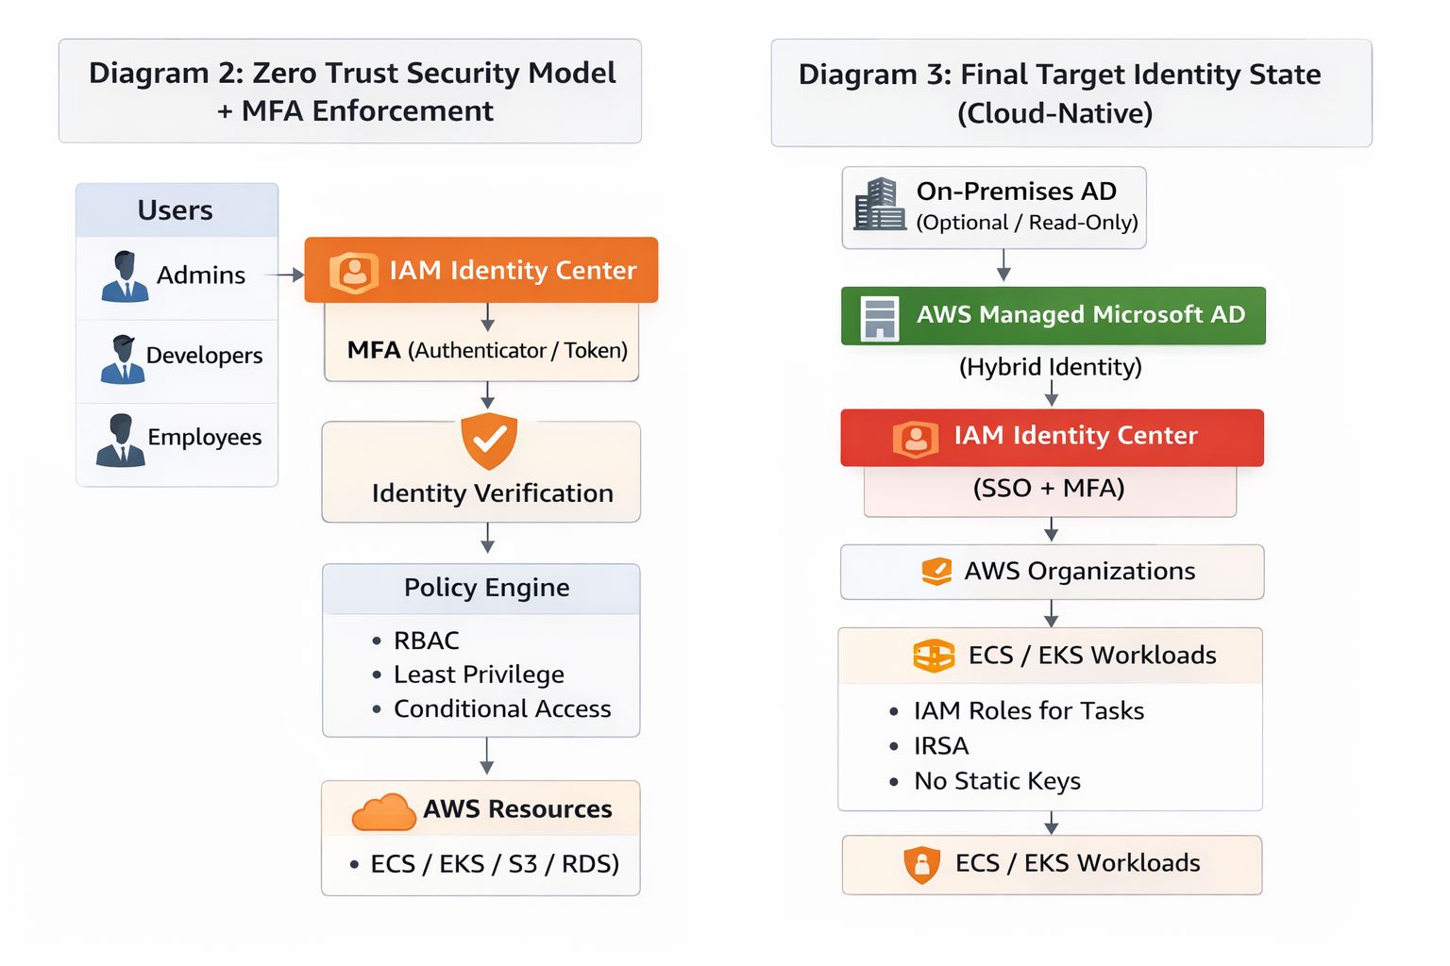
Task 1 (Identity)
Identity modernisation (Task 1): diagrams
Appendix: Task 1 Identity Migration Diagrams

Slide 13
Wrap-up
Conclusion
Successfully delivered a cloud-native microservices deployment on AWS.
Used Docker + ECS Fargate + ALB for scalable runtime and routing.
Provisioned everything via CloudFormation (repeatable IaC).
Implemented automated CI build and image publishing to ECR.
Validated observability with dashboards, alarms, and SNS notifications.
Documented and resolved real CI issues (IAM + rate limiting).
Final message
The solution is secure, repeatable, and ready to evolve into full CI/CD and production hardening.
End of presentation

